Slide 1
FIRST 2021 Season
https://meet.google.com/vew-oqsa-vbr

Slide 2
Infinite Recharge
2 teams of 3 bots compete to complete a set of tasks lasting 3 minutes
The first stage involves shooting 9 power cells into one of the 2 ports.
The next stage involves spinning a ‘control panel’ at least 3 but no more than 5 times, and scoring 15 power cells in one of the 2 power ports.
The third stage requires the control panel to be positioned on a specific color (we currently cannot do that, and requires 15 power cells in one of the 2 power ports.
The final 30 seconds of the match is dedicated to hanging your bot from a teetering bar in the center area of the play field.
Game Animation: https://www.youtube.com/watch?v=gmiYWTmFRVE
Field Tour :https://www.youtube.com/playlist?list=PLfvRVPl9tzZrGCEbjsZ7mMFvxUDI7yFQC

Slide 3
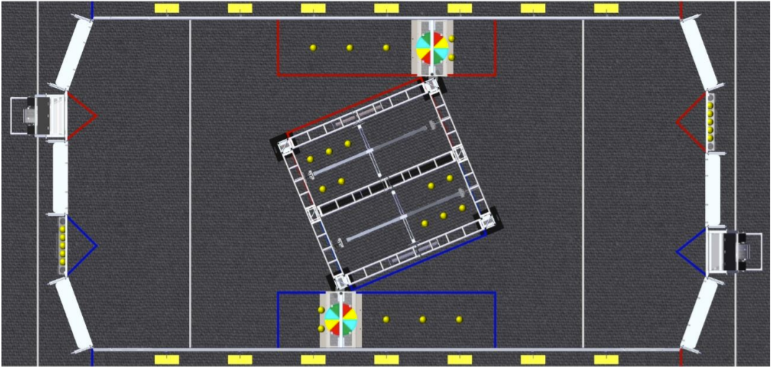
Field

Slide 4
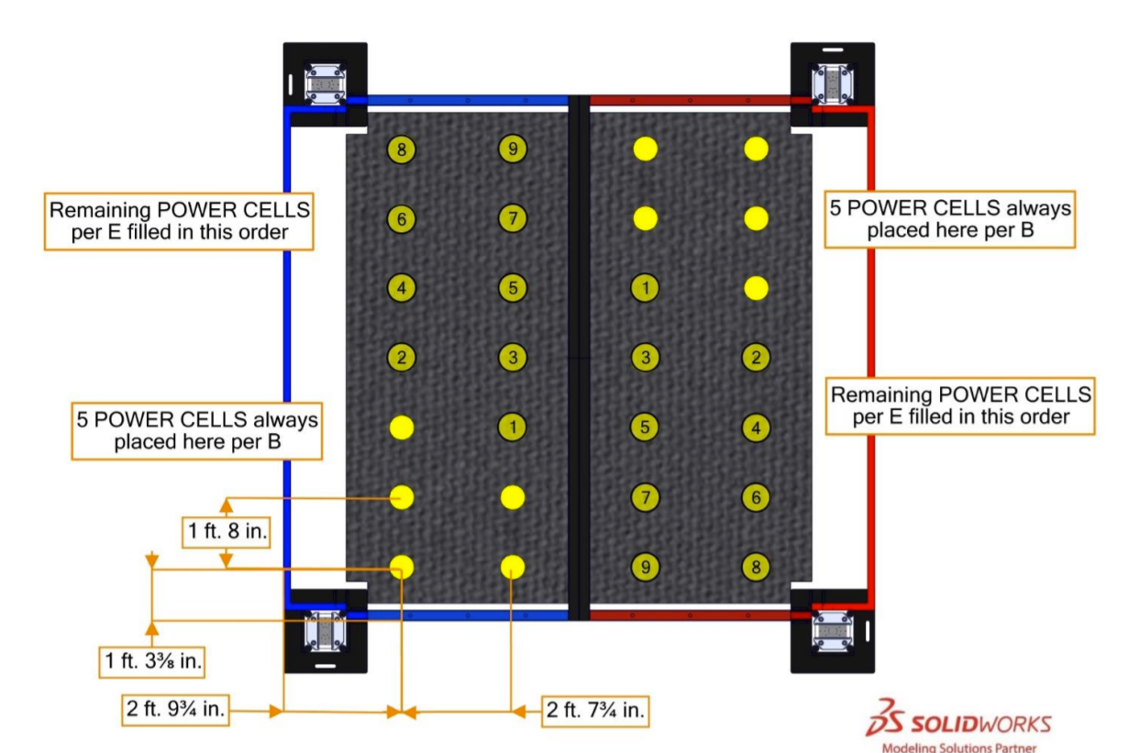

Slide 5
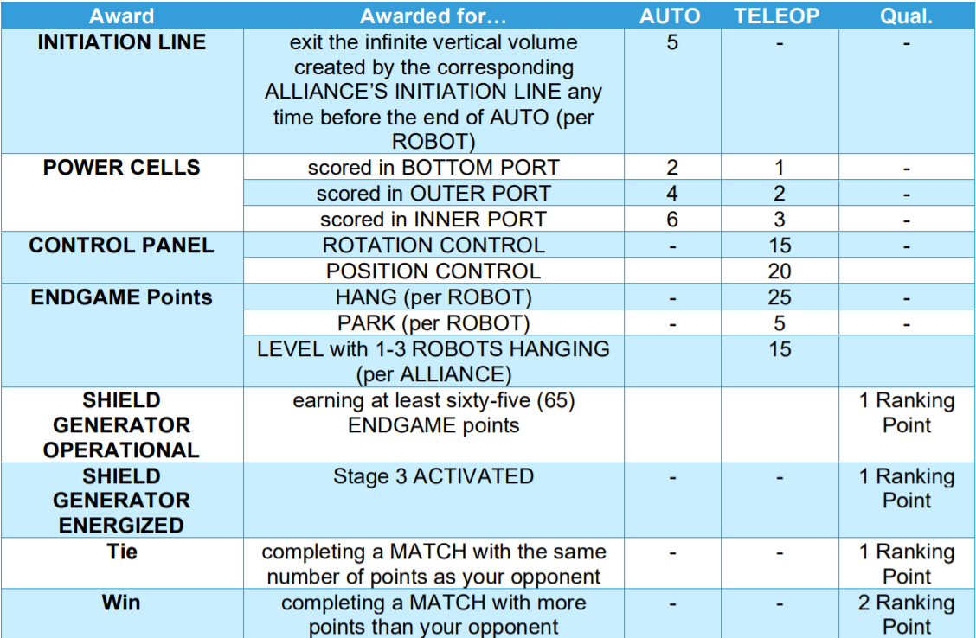
Points

Slide 6
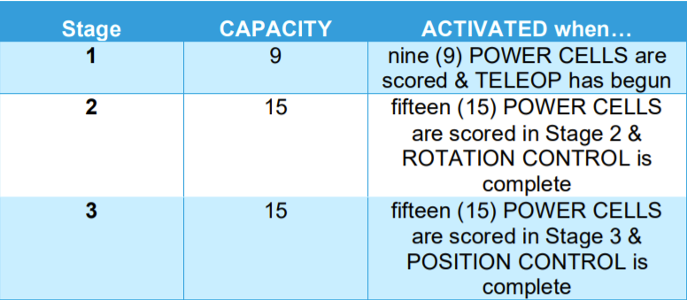

Slide 7
At Home Challenges

Slide 8
How To Submit
Deadlines
Frcathome.org
Code:
1. In the Team Dashboard, go to the `Team Options' section
2. Click on `Payment & Product.'
3. Click on `Passwords/Voucher Codes'
4. Locate the 12-character code listed under FIRST/FRC at Home Key that begins with "F
Opens: February 4th
Closes: March 4th

Slide 9
FIRST Innovation

Slide 10
Challenge
Identify a problem to help people keep, regain, or achieve optimum physical and/or mental health and fitness through active play or movement.
Identify Problem
Brainstorm and Design
Develop Business Model
2 Minute Business Pitch
Use Technology in Solution

Slide 11
Judgement Guidelines
Problem or Opportunity
Business Model
Innovation Impact
Design
Business Pitch

Slide 12
Interview
All teams who submit applications for the Innovation Challenge will be given a 15 minute interview which consists of:
2 min Business Pitch
Focused on Business Model
3 min Presentation
Describe Impact, Design, Tech with Drawings and CAD to reinforce
10 min Q&A

Slide 13
Advancement
Teams put into groups regardless of location
Groups of 20-30 Teams
Semi-Finalists are chosen, then 20 Finalists are chosen from Semi-Finalists
Get to go to FIRST Innovation Awards

Slide 14
Infinite Recharge At Home

Slide 15
Skill Challenges :
Galactic Search Challenge : teams emulate the Autonomous Period of INFINITE RECHARGE gameplay by locating and collecting POWER CELLS as fast as they can on one of two(2)pairs of paths.
AutoNav Challenge : teams program their ROBOTS to autonomously drive predetermined routes through three (3) different paths as fast as possible.
Hyperdrive Challenge : teams drive their ROBOTS remotely, without the assistance of pre-programmed navigation, through four (4) different paths as fast as possible. The first three (3)paths are the same as those described in AutoNav Challenge, the fourth path is the Lightspeed Circuit path.
Interstellar Accuracy Challenge : In the Interstellar Accuracy Challenge teams emulate the shooting challenges of INFINITE RECHARGE gameplay by scoring POWER CELLS into a representation of the BOTTOM PORT, OUTER PORT,AND INNERPORTfrom four (4) zones. Teams will attempt to score as many points as possible in five(5)minutes.

Slide 16
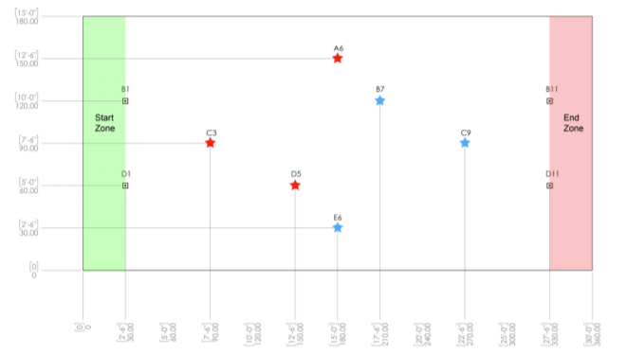

Slide 17
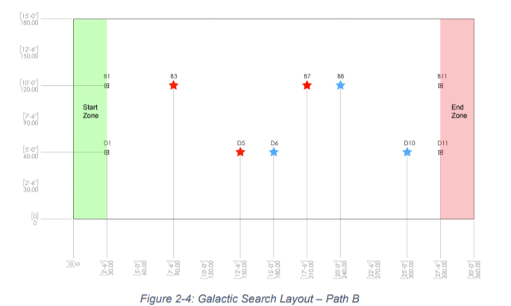

Slide 18
Hyperdrive Challenge
Goes as fast as possible through different paths:
Barrel Racing
Slalom
Bounce
Lightspeed Circuit

Slide 19
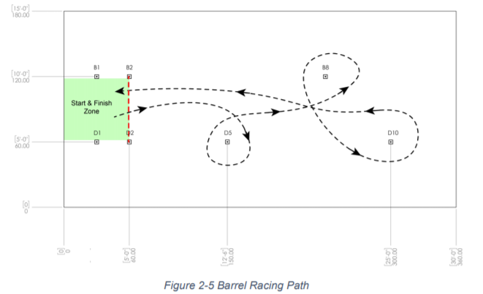

Slide 20
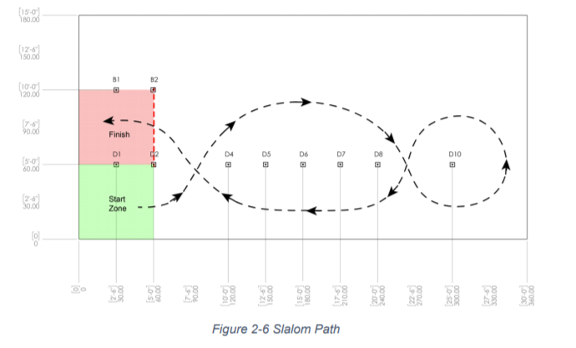

Slide 21
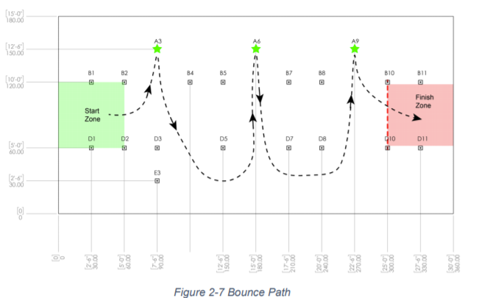

Slide 22
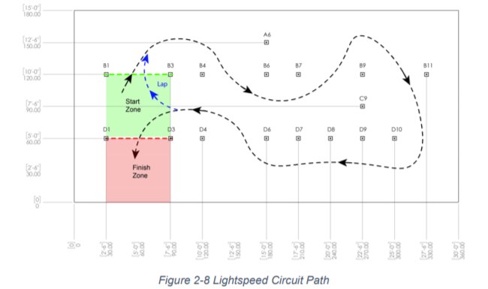

Slide 23
Accuracy Challenge
Score lots of points from different zones

Slide 24
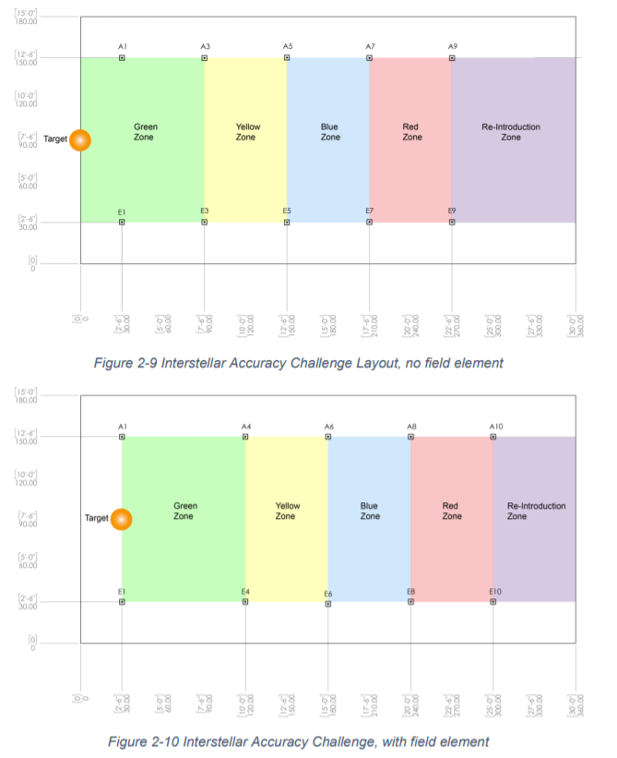

Slide 25
Game Design Challenge

Slide 26
Submission
Must Submit:
Game Name
Image of the Field (Sketch, Photo, Cad, etc.)
Game Overview (500 wrd limit)
Description of Field Elements
Expected Robot Actions
How Field Elements are used by Robots
Optional: 2 min Video
Will be Interviewed

Slide 27
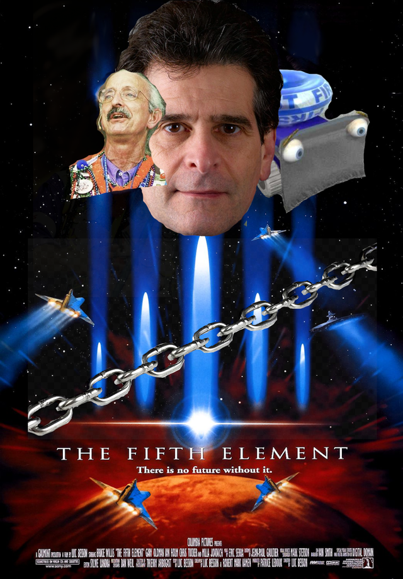
Game Design Challenge Element
The Chain
Not required, but must be used for Concept Award
Will be asked how they implemented it in their submission

Slide 28
Awards for Game Design
Designer’s Award – Celebrates a team’s outstanding success with the Game Design Challenge. The winner of this award should be a strong candidate for some other awards in this challenge. o To be eligible for this award a team is not required to use the Game Design Challenge ELEMENT.
Concept Award – Celebrates a team that creates an interesting, realistic game concept. o To be eligible for this award a team is required to use the Game Design Challenge ELEMENT.
Imagery Award in honor of Jack Kamen – In honor of Jack Kamen, Dean’s father, for his dedication to art and illustration and his devotion to FIRST. This award celebrates attractiveness in visual aesthetic integration.
Creativity Award sponsored by Rockwell Automation – Celebrates creativity that enhances the overall game design concept.
Engineering Design Award – Celebrates the team that demonstrates sound engineering in the design process.
Rookie Design Award (optional) - Celebrates the rookie team’s outstanding success in the Game Design Challenge

Slide 29
Traditional Awards
Chairman
The team that represents the best model for FIRST and the mission of FIRST
FIRST Dean’s List
10th and 11th
Academic Excellence
How Student increased awareness for FIRST
Technical Experience, Entrepreneurship, and Creativity
Leadership
Woodie Flowers Finalists
Students select Mentor for Award
WIll be put into Southeastern Region and compete with other teams in Alabama, Arkansas, Louisiana, and Mississippi.

Slide 30

Ethan Slide

